Slide 1
Magnolia Drive Corridor Study

Slide 2
Partners and Roles
CRTPA
Identified Need
Directed Funding
City of Tallahassee
Maintaining Agency
Funding
Leon County
Project Management
Funding
FDOT
$860,000 in funding
Blueprint2000
Opportunity for funding
The Public
Guidance

Slide 3
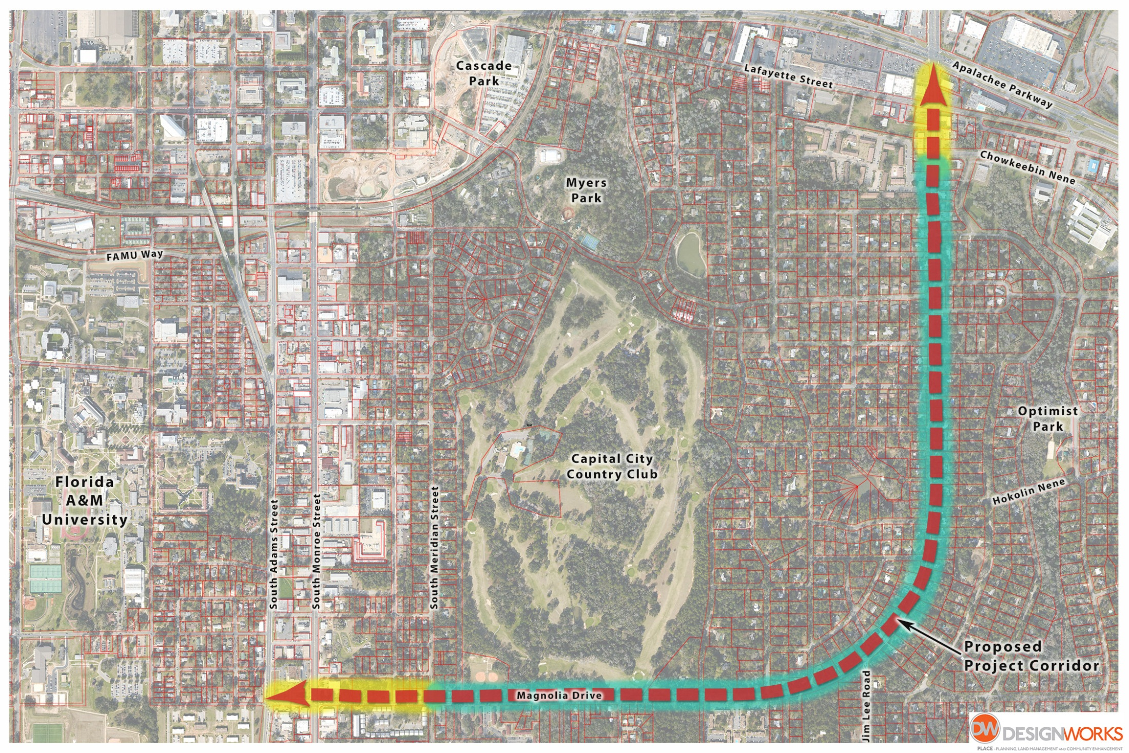
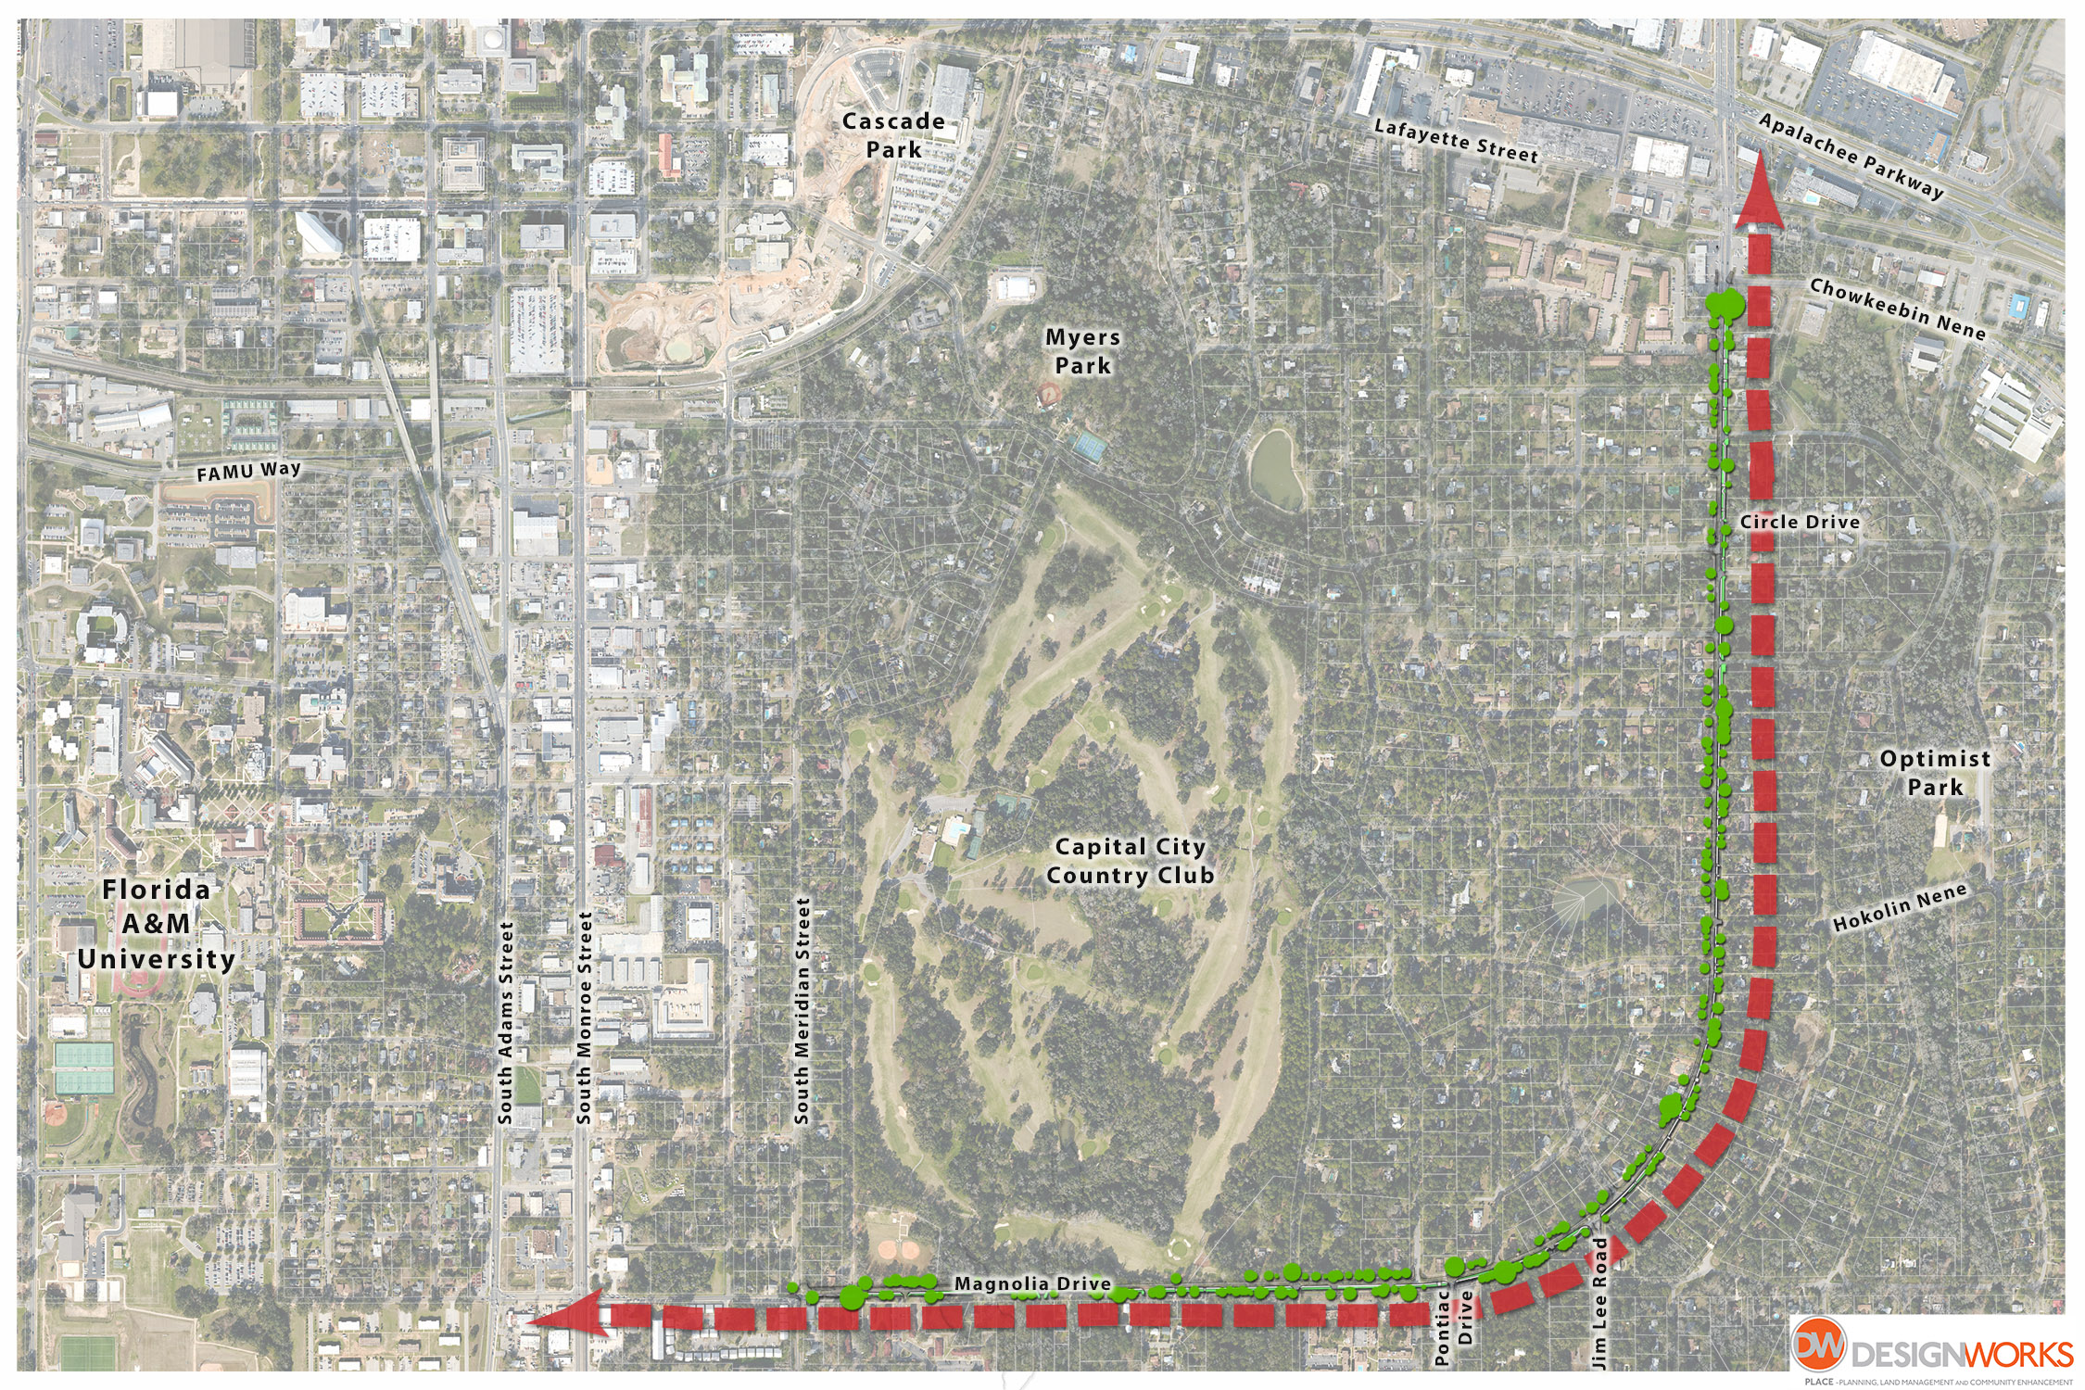
Project Area
Magnolia Drive from Apalachee Parkway to South Adams Street

Slide 4
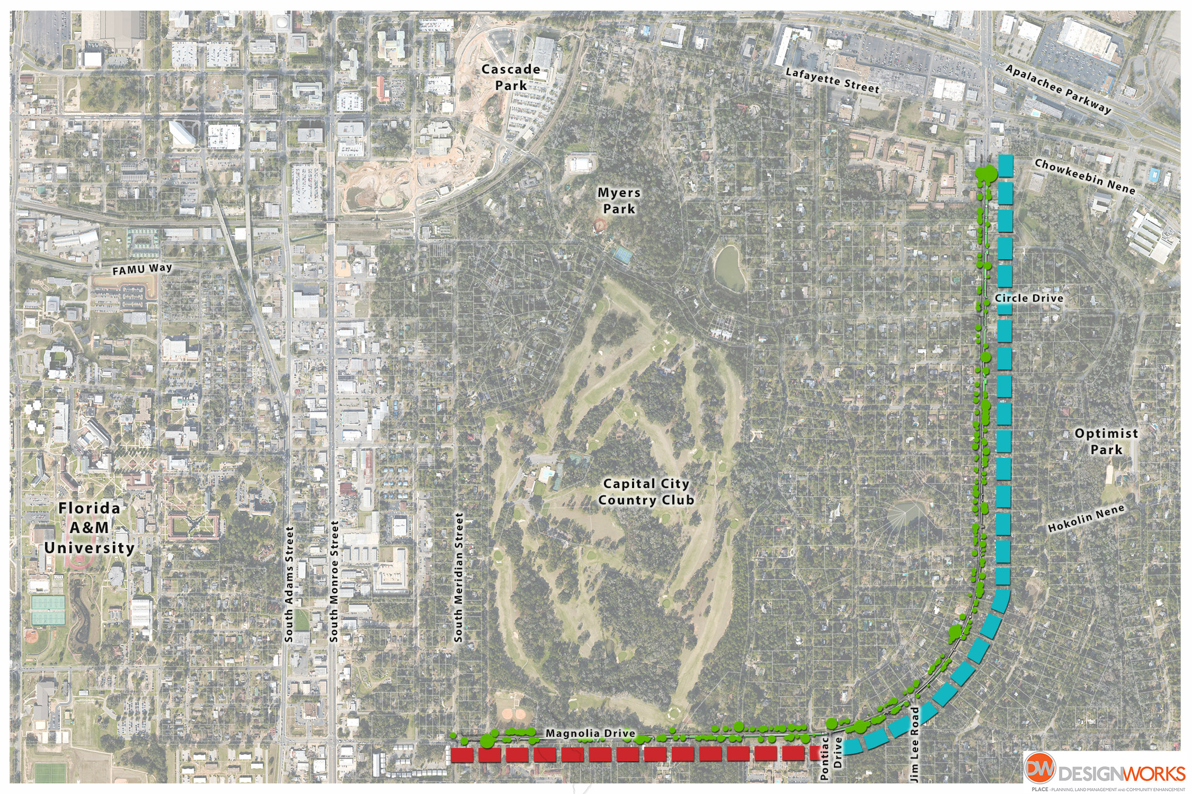
Magnolia Drive Multi-Use Path
Phase 1: Meridian Street to Pontiac Drive
Phase 2: Pontiac Drive to Chowkeebin Nene
Phase II
Phase I

Slide 5
Phase I: 10’ Multi-Use Trail on South Side of Magnolia from Meridian to Pontiac
Estimated Construction Cost: $ 1.08 Million
Pending Federal Grant for Phase I: $860k

Slide 6
Phase 2: Completion of 10’ Multi-Use Trail from Pontiac to Chowkeebin Nene
Estimated Construction Cost: $3.5 Million

Slide 7
Apalachee Parkway to Circle Drive Sidewalk - Sidewalks
Estimated costs: $500k

Slide 8
Magnolia Drive and Jim Lee – Intersection Signalization
Estimated costs: $330k

Slide 9
Magnolia Drive from Alban Avenue to Seminole Drive - Sidewalk
Estimated costs: $300k

Slide 10
Meridian Street to South Monroe Street – 10’ Wide Multi-Use Trail
Estimated costs: $600k

Slide 11
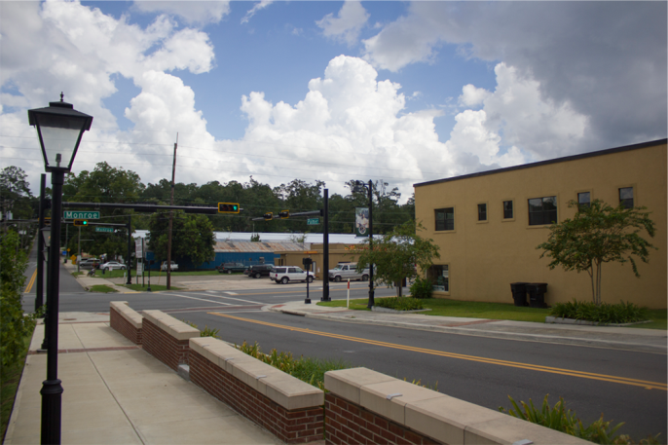
South Adams Street to South Monroe Street – 10’ Wide Sidewalk and Streetscape Improvements
Estimated costs: $400k (Assuming no R.O.W. acquisition)
Palmer Avenue

Slide 12
Complete Sidewalk Network on North and West side of Magnolia Drive
Estimated costs: $3.75 Million

